Slide 1


Joseph Clay
Advanced Web Tech
Term-Project

Slide 2

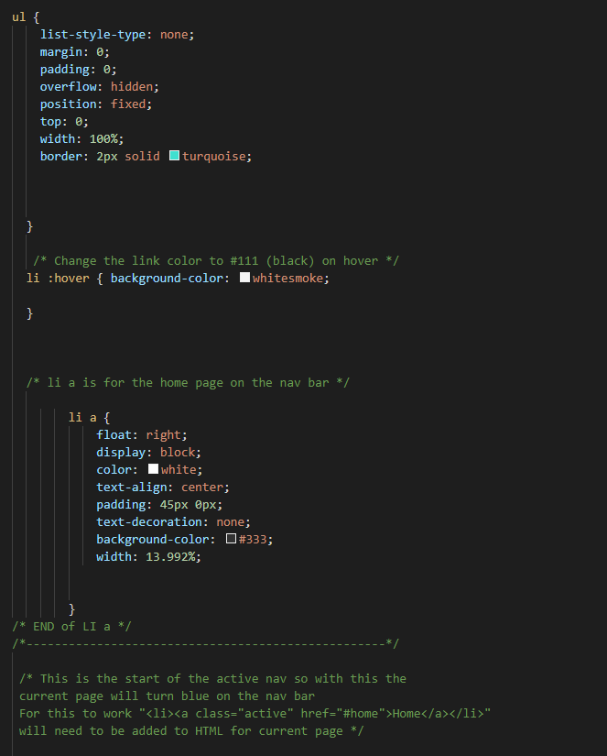
Home Page and mostly HTML, CSS, and JS
A scrolling nav bar that stays at the top of the screen
Hover Over Nav Bar & color changing active page
Lots off CSS were scrapped to focus more on PHP

Slide 3
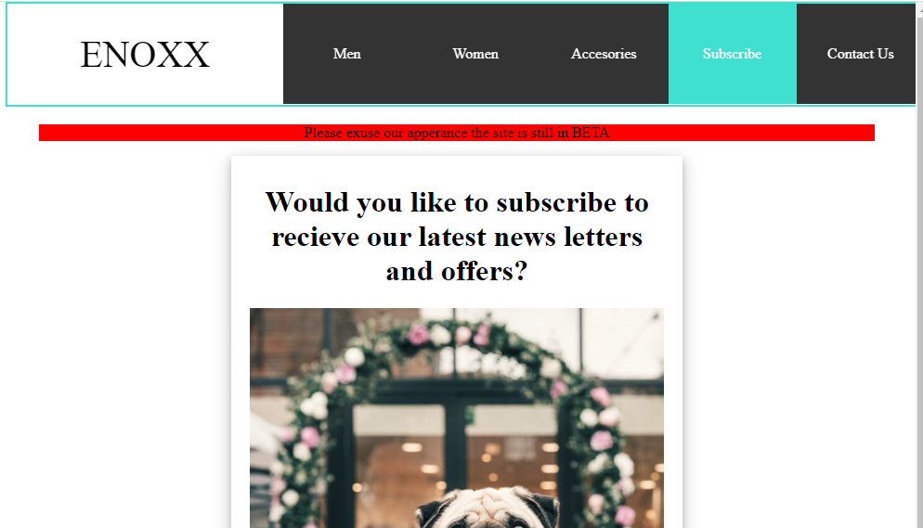
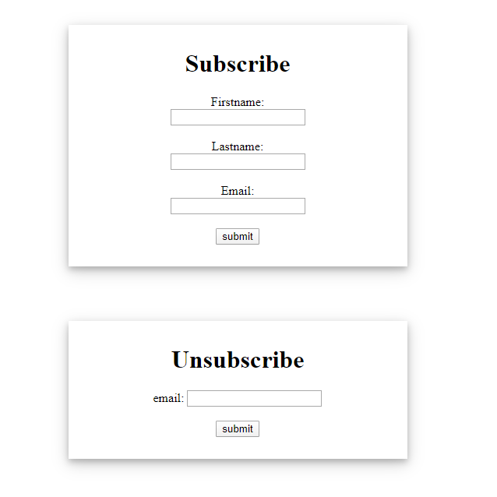

Subscribe
Form that prompts for First name, Last, Email
Unsubscribe that prompts for just email
A confirmation page with a JS button to bring you back to the homepage

Slide 4
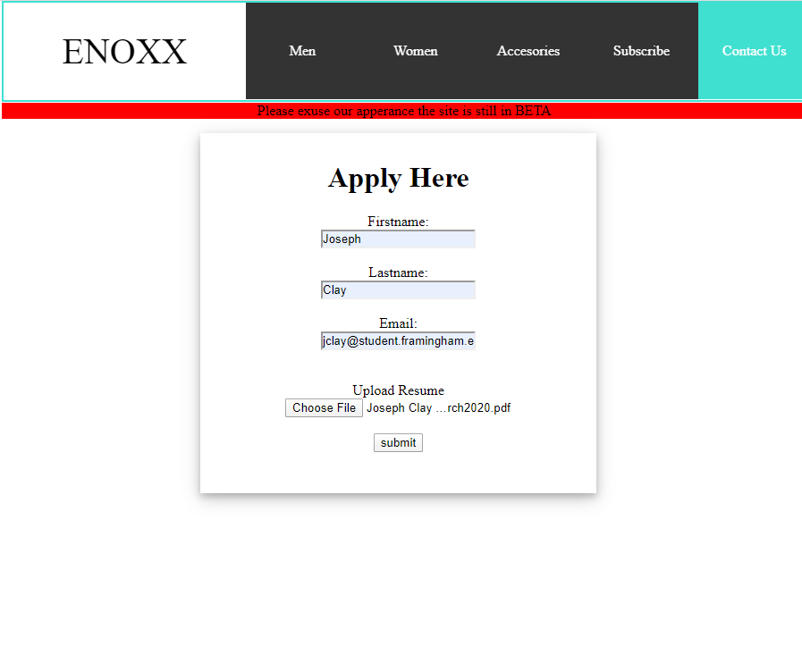
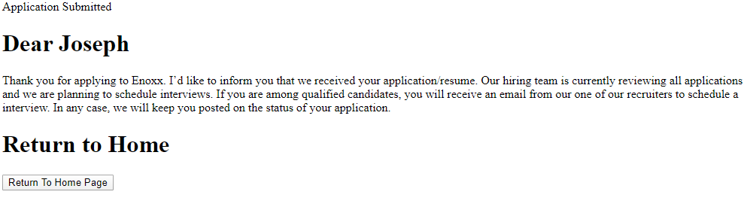
Application
Form that prompts for First name, Last, Email
Allows for user to submit their resume in the form of a file

Slide 5
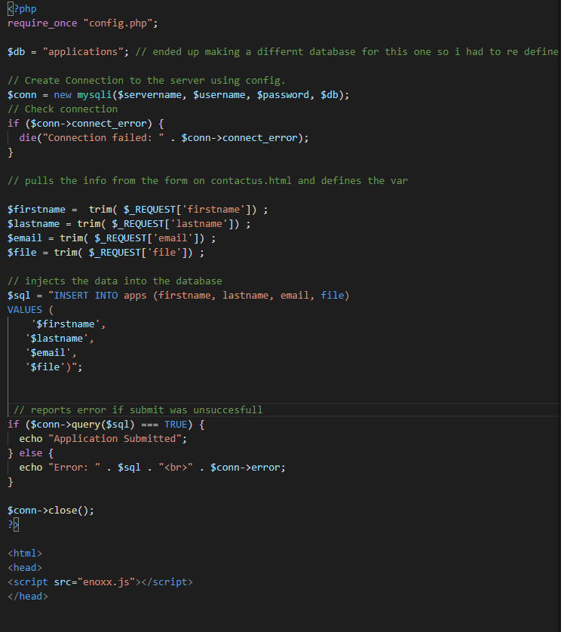
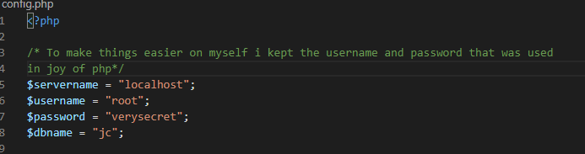
PHP Behind Application
Pulls login info for server from config file
Pulls the info from the form on contactus.html and defines the var
Inserts the variables into a database named applications

Slide 6
Ending thoughts
Would have loved to have a shopping cart
Also whish I had thought about a login

